Slide 1
Shine My Room
Ao Li & Morten Knudsen
12/6-2017

Slide 2
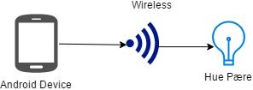
Shine My Room is an app for people with Philips Hue lightbulbs and what to change the light through an app
Concept diagram:

Slide 3
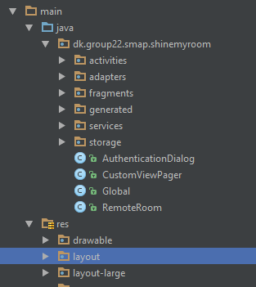
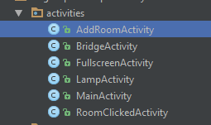
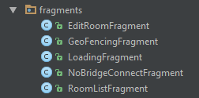

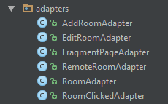

App projekt overview

Slide 4
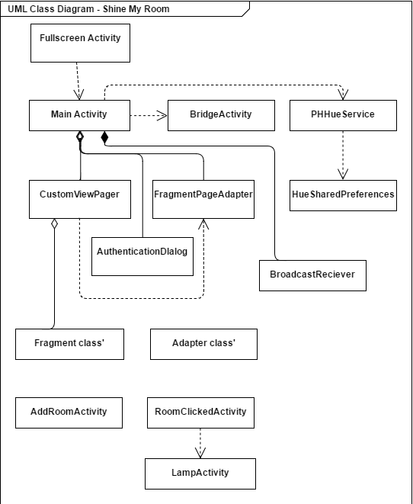
Main components
Activities
Intents
Service
Broadcast Receiver
Adapters
Fragments
Storage

Slide 5
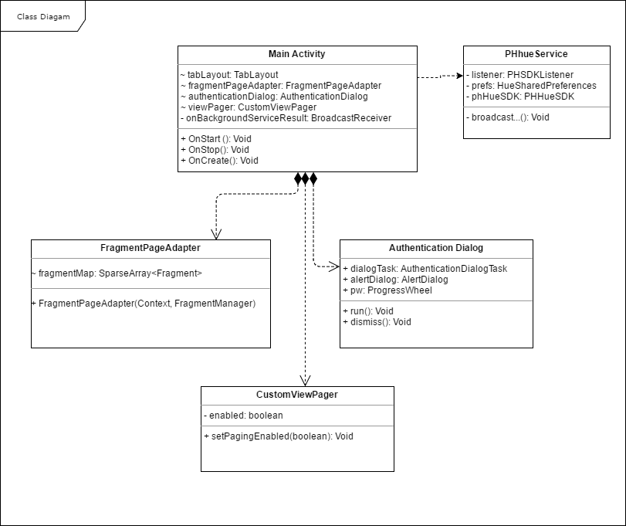
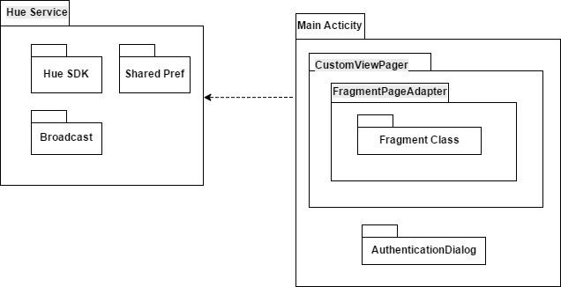

Slide 6
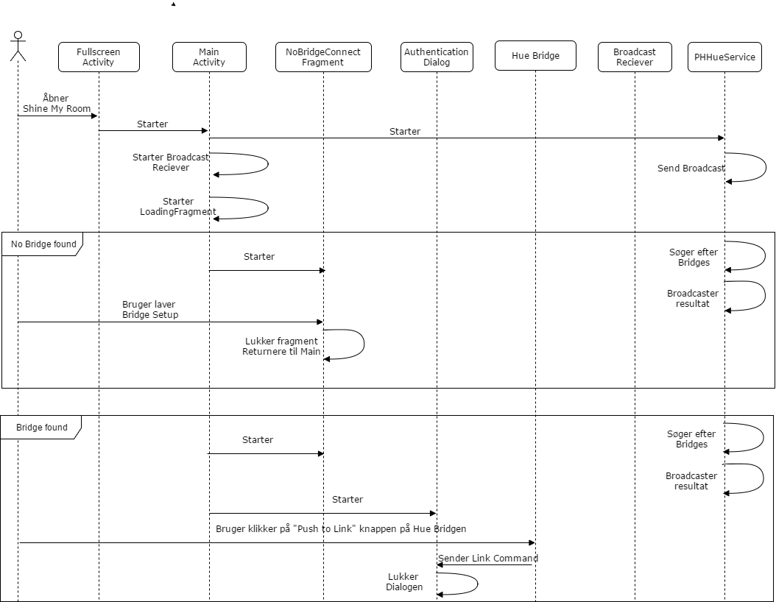
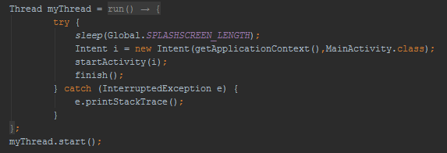
Activities & Intents

Slide 7

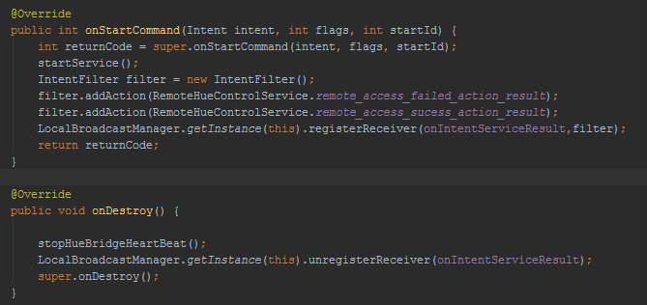
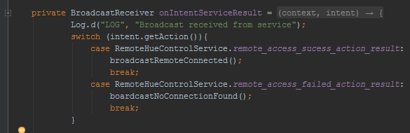
Service & Broadcast Receiver

Slide 8
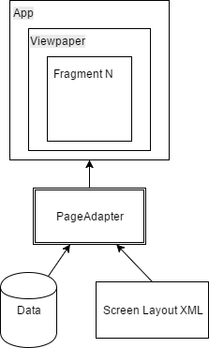
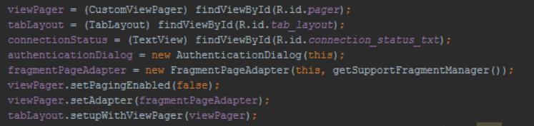
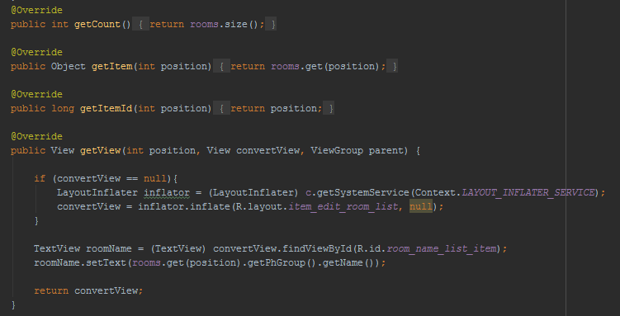
Adapters & Fragments

Slide 9
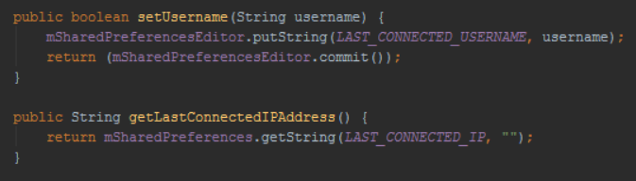
Storage
Shared Preferences

Slide 10
Android Framework
Splash screen, Tabbed Layout, Shared prefrences, ContentProviders, Managers, Ressource,
Geofencing, Color change through ressources,
Pros
”Open Source”, Garbage collection, Google Play Services, Documentation
Cons
Bloated code, Documentation

Slide 11
Demonstration

